Slide 1
Gender Inequality
Prepared by: Todor Todorov, Riste Petrov, Martin Georgiyashev

Slide 2
Gender Proportion
General look at the data first!
How much did men and women participate in household work?
Who was more likely to be a researcher?
Gender inequalities in the labour market

Slide 3
Gender Proportion - 1986
Value | Gender | Count | Percent
0 | Women | 5593 | 52.24
1 | Men | 4740 | 47.59
Total |  | N =10333 | 100

Slide 4
Gender Proportion - 2024
Value | Gender | Percent
0 | Women | 52.24
1 | Men | 47.59
https://www.nsi.bg/

Slide 5
Were there really less men than women?
Sample: 10333
Test of Hypothesis: Mean = 0.5
Sample Mean = 0.458724
Sample Std. Dev. = 0.498318
Method Value Probability
t-statistic -8.419759 0.0000
We can conclude with 95% degree of confidence, that in 1995 there were less Men than Women living in Bulgaria!

Slide 6
Household Participation
Value | Chore Participation | Count | Percent
1 | No Participation | 435 | 4.21
2 | Just in few household activities | 464 | 4.49
3 | Only regular activities | 325 | 3.15
4 | All household work | 9109 | 88.15

Slide 7
Do 88.15% really participate in All household work
Value | Household work Participation | Test Count | Test Percent
1 | No Participation | 734 | 7.11
2 | Just in few household activities | 783 | 7.58
3 | Only regular activities | 549 | 5.31
4 | All household work | 8266 | 80
Chi-squared test:
χ²=≈429.2
Critical value χ²₀.₉₅,3 ≈ 7.815
429.2 > 7.815
Reject the H₀: only 80% participate in
All household work

Slide 8
Distribution of Household word between Gender
Test Statistics |  | df | Value | Prob
Pearson X2 |  | 3 | 944.0482 | 0
Likelihood Ratio G2 |  | 3 | 1057.283 | 0
Count |  | HOUSEHOLD WORK
% Row |  | 1 | 2 | 3 | 4
% Col |  | No participation | Just in few household activities | Only regular activities | All household work | Total
GENDER | Women | 83 | 76 | 7 | 5427 | 5593
 |  | 1.48 | 1.36 | 0.13 | 97.03 | 100
 |  | 19.08 | 16.38 | 2.15 | 59.58 | 54.13
 | Men | 352 | 388 | 318 | 3682 | 4740
 |  | 7.43 | 8.19 | 6.71 | 77.68 | 100
 |  | 80.92 | 83.62 | 97.85 | 40.42 | 45.87
 | Total | 435 | 464 | 325 | 9109 | 10333
 |  | 4.21 | 4.49 | 3.15 | 88.15 | 100
 |  | 100 | 100 | 100 | 100 | 100

Slide 11
Test Statistics | df | Value | Prob
Pearson X2 | 1 | 175.9486 | 0
Likelihood Ratio G2 | 1 | 175.9486 | 0
Statistically Significant

Slide 12
Test Statistics | df | Value | Prob
Pearson X2 | 1 | 1222.052 | 0
Likelihood Ratio G2 | 1 | 1282.072 | 0
Statistically Significant

Slide 13
Basic Demographics
 | coefficient | std. Error | z | P-value | Meaning of coeff - Better
const | 2.4844 | 0.0848 | 29.3070 | 8.43E-189 | Baseline
TOWN | -0.5160 | 0.0168 | -30.6760 | 1.19E-206 | Lower (Sofia)
AGE | -0.0452 | 0.0015 | -30.6077 | 9.68E-206 | Lower (Younger)
GENDER | 0.7216 | 0.0478 | 15.0974 | 1.69E-51 | Higher (Male)
EDU | Uncomplete sample size
McFadden R2 | 0.1867 | Adjusted R2 | 0.1860 | Akaike criterion | 10769.7288
 | Predicted | 1 | 0 |  | Accuracy | 72.06%
Actual | 0 | 5762 | 1070 |  | Precision: | 61.15%
Actual | 1 | 1817 | 1684 |  | Recall: | 48.10%
 |  |  |  |  | F1: | 53.84%

Slide 14
Appliances connected with R&D
Marginal effect | coefficient | std. Error | z | P-value | Meaning of coeff - Better
const | 0.1765 | 0.4028 | 0.4383 | 0.6612 | Baseline
BOOKS | 0.0032 | 0.0004 | 7.9282 | 2.22E-15 | Marginal effect
KASETOFON | -0.1966 | 0.0186 | -10.5861 | 3.46E-26 | Lower (freq usage)
RADIO | -0.1169 | 0.0210 | -5.5549 | 2.78E-08 | Lower (freq usage)
TV | -0.3046 | 0.0373 | -8.1665 | 3.17E-16 | Lower (freq usage)
VIDEO | 0.1952 | 0.0947 | 2.0611 | 0.0393 | High P value
CAR | -0.1681 | 0.0184 | -9.1133 | 7.99E-20 | Lower (freq usage)
PC |  |  |  | 0.41
ELECTRIC_GAMES |  |  |  | 0.48
McFadden R2 | 0.1551 | Adjusted R2 | 0.1541 | Akaike criterion | 11192.9378
 | Predicted | 0 | 1 |  | Accuracy | 73.32%
Actual | 0 | 6183 | 649 |  | Precision: | 68.60%
Actual | 1 | 2083 | 1418 |  | Recall: | 40.50%
 |  |  |  |  | F1: | 50.93%

Slide 15
Work related factors
 | coefficient | std. Error | z | P-value | Meaning of coeff - Better
const | -0.4492 | 0.1103 | -4.0712 | 4.67681826025839E-05 | Baseline
FARMINGS | 0.1781 | 0.0159 | 11.1859 | 4.78E-29 | Higher (less farming)
WORK_CONDITIONS | 0.1361 | 0.0156 | 8.7504 | 2.13E-18 | Higher (Excellent cond)
DIPLOMA_GAP | -0.2839 | 0.0110 | -25.8392 | 3.21795442574199E-147 | Lower (Perfect fit)
WAGE | 0.0010 | 0.0002 | 4.1591 | 3.19458992647511E-05 | Marginal effect
OCCUPATION |  |  |  | 0.3017
McFadden R2 | 0.1439 | Adjusted R2 | 0.1432 | Akaike criterion | 11336.2
 | Predicted | 0 | 1 |  | Accuracy | 73.32%
Actual | 0 | 5794 | 1038 |  | Precision: | 63.19%
Actual | 1 | 1719 | 1782 |  | Recall: | 50.90%
 |  |  |  |  | F1: | 56.38%

Slide 16
Lesure Activites
 | coefficient | std. Error | z | P-value | Meaning of coeff - Better
const | 3.0615 | 0.1889 | 16.2114 | 4.19E-59 | Baseline
ARTS_ACT | 0.4359 | 0.0520 | 8.3842 | 5.11E-17 | 2 - Participation
BIRTHDAYS | -0.3974 | 0.0221 | -17.9477 | 5.00E-72 | Lower (more celebrations)
DRINKING | 0.0557 | 0.0237 | 2.3502 | 0.0188 | Marginal effect
MOVIES | -0.4703 | 0.0229 | -20.5514 | 7.48E-94 | Lower (freq. watching)
MUSEUMS | 0.0263 | 0.0069 | 3.8068 | 0.0001 | Marginal effect
OPERA | 0.0262 | 0.0163 | 1.6099 | 0.1074 | HIGH - P - value
SMOKING | 0.0091 | 0.0028 | 3.2978 | 0.0010 | Marginal effect
SPORT | -0.5076 | 0.0298 | -17.0149 | 6.36E-65 | Lower (freq. excersized)
THEATRE | 0.1723 | 0.0135 | 12.7772 | 2.20E-37 | Higher (better)
POP CONCERTS | Small sample size
McFadden R2 | 0.2699 | Adjusted R2 | 0.2684 | Akaike criterion | 9680.0135
 | Predicted | 0 | 1 |  | Accuracy | 77.63%
Actual | 0 | 6015 | 817 |  | Precision: | 71.07%
Actual | 1 | 1494 | 2007 |  | Recall: | 57.33%
 |  |  |  |  | F1: | 63.46%

Slide 17
Reading
 | coefficient | std. Error | z | P-value | Meaning of coeff - Better
const | 7.0841 | 0.2295 | 30.8647 | 4E-209 | Baseline
READING_ECON | -1.0349 | 0.0464 | -22.3254 | 2E-110 | Less (More reading)
READING_LIT | -0.6291 | 0.0213 | -29.4748 | 6E-191 | Marginal effect
READING_POETRY | -0.2720 | 0.0233 | -11.6681 | 2E-031 | Marginal effect
McFadden R2 | 0.3327 | Adjusted R2 | 0.3321 | Akaike criterion | 8836.7362
 | Predicted | 0 | 1 |  | Accuracy | 80.16%
Actual | 0 | 6123 | 709 |  | Precision: | 75.29%
Actual | 1 | 1341 | 2160 |  | Recall: | 61.70%
 |  |  |  |  | F1: | 67.82%

Slide 18
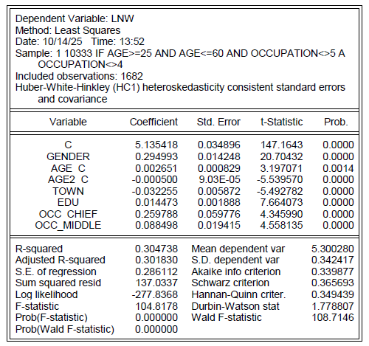

Slide 19
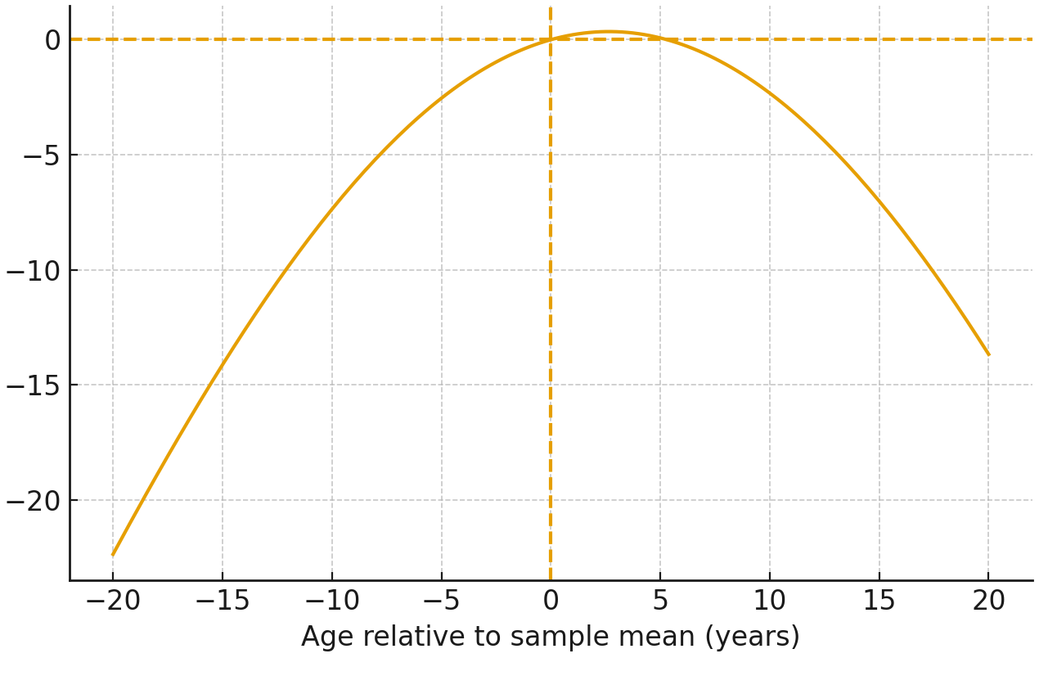

Slide 20
